Slide 1

Online Influencer Product Recommendation System
Module 1: Data Processing and
Exploratory Data Analysis
Group 23
Chen, Xinyao
Niravane, Anagha
Qiu, Emily
Peng, Yulin
Liu, Yijia

Slide 2
Table of Contents
Project Introduction
Data Description and Acquisition
Influencer Profile Dataset
Influencer Post Dataset
Amazon Product Reviews Dataset
Keyword Search Dataset
Dataset Preprocessing, Feature Engineering, and EDA
Influencer Profile Data Processing
Influencer Post Data Processing
Amazon Product Review Data Processing

Slide 3

Project Introduction
Background: With the rise of social media and e-commerce integration, influencers have become a key force in driving online sales through product promotions. Selecting the right products to promote remains a challenge, as influencers need to balance market trends with their personal brand and audience preferences.
Project Goal: Develop a product recommendation system tailored for online influencers on social media platforms.
By analyzing both trending products and influencer characteristics, our system helps creators identify the most suitable products to promote, maximizing their sales potential and commission earnings.
This data-driven approach not only enhances influencer revenue streams but also optimizes brand partnerships by ensuring more effective product placements.

Slide 4
Data Description and Acquisition - Overview
The recommendation system is built based on four datasets, which provides data support from the aspects of influencers themselves, their created content, product feedback and product popularity on the internet.
These datasets are the foundation for implementing influencer-based collaborative filtering and content-based filtering.
Influencers Profile Dataset
Influencers Post Dataset
Amazon Product Review Dataset
Desktop Search Keyword Dataset
detailed information about influencers (e.g. demographics, niche and follower count)
influencers content from Instagram, including post metadata, captions, engagement metrics, and sponsored tags
product reviews, ratings, helping identify trending and high-quality products in different categories.
From Dewey Dataset, Contain the keywords driving clicks to websites via organic searches

Slide 5
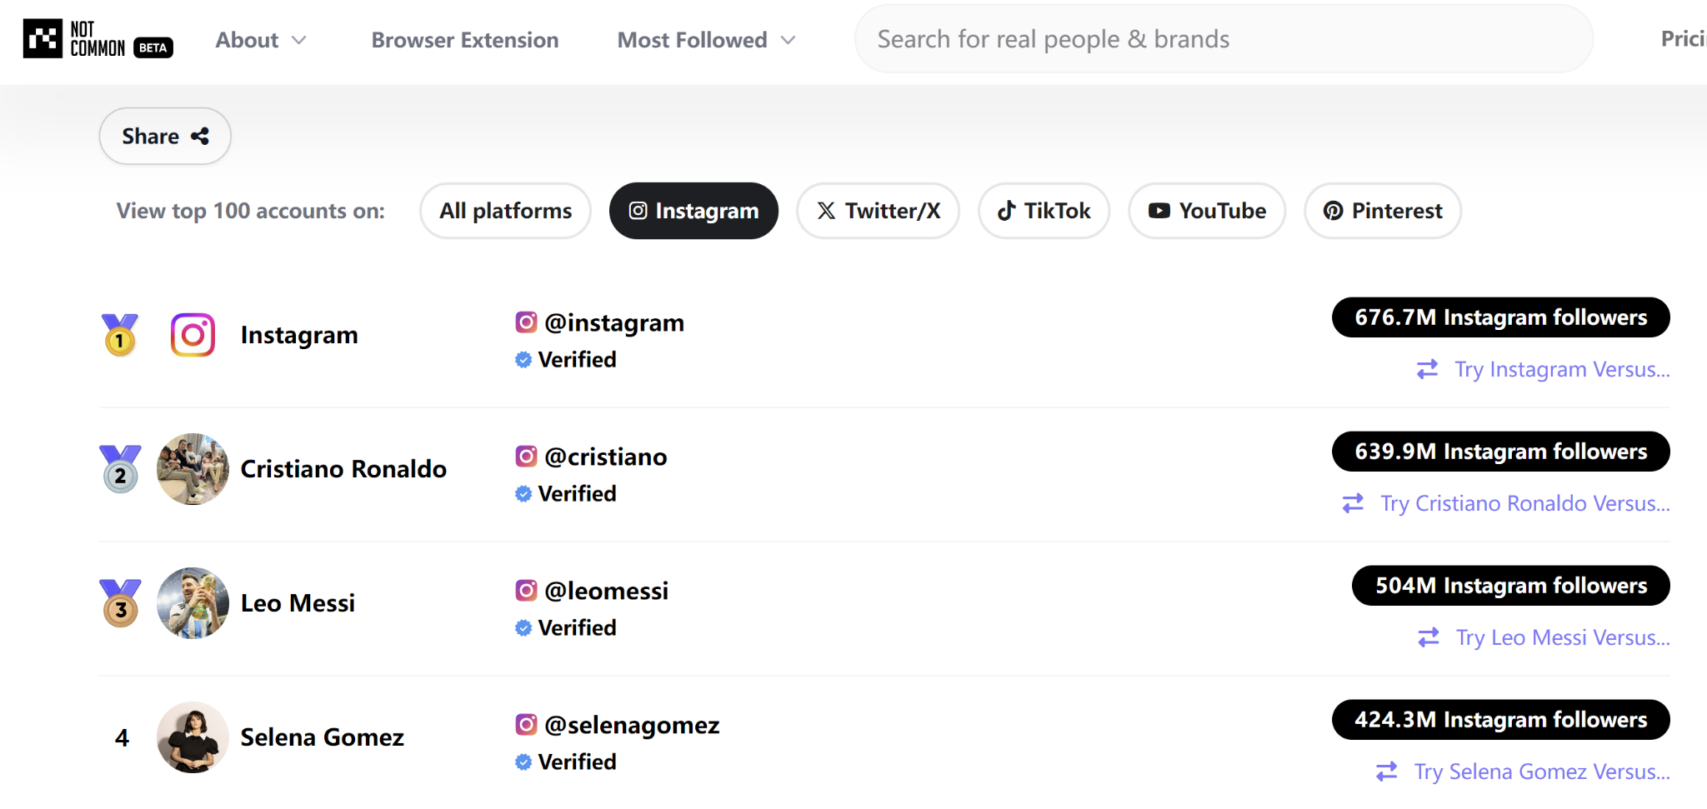
Data Acquisition - Influencer Dataset
The influencer profile dataset and post dataset were acquired through a combination of web crawling and the Instagram API.
Data Collection Process for instagram influencers profile and post datasets
Used web crawler to extract the accounts of 8,000 influencers from Not Common, a platform that tracks the most-followed Instagram users.
Used Instagrapi API to obtain the detailed profiles of 3,000 influencers.
Filtered out business accounts and focused only on non-business influencers.
Retrieved up to 300 of the most recent posts for each non-business influencer.

Slide 6
Data Description - Influencer Dataset
Influencer Profile Dataset
2. Influencer Post Dataset
User ID: Unique identifier for the Instagram account.
Username: Instagram handle of the influencer.
Full Name: Real name of the influencer.
Category: Influencer type (e.g., Athlete, Actor).
Follower Count: Total number of followers.
Media Count: Total number of posts published.
Is Business:whether s a business or personal account.
Is Verified: whether the account has a verified badge.
Biography: Self-description provided by the influencer.
Profile Picture URL: Link to the profile image.
Instagram Location ID: Geolocation ID
User ID: Unique identifier of the post creator.
Post ID: Unique identifier of each post.
Date: Timestamp of post publication.
Media Type: Specifies whether the post is a photo, video, or album (multiple images/videos).
Caption: Text description provided in the post.
Comments: Number of comments received.
Likes: Number of likes on the post.
Views: Number of views (for videos).
Media URLs: Links to attached photos or videos.
Sponsor Tags: whether the post is sponsored.
Usage in the recommendation system: These datasets allow us to identify successful promotional content(i.e. which types of posts generate high engagement) and influencers with similar characteristics, essential for conducting collaborative filtering and content-based filtering for our recommendation system.

Slide 7
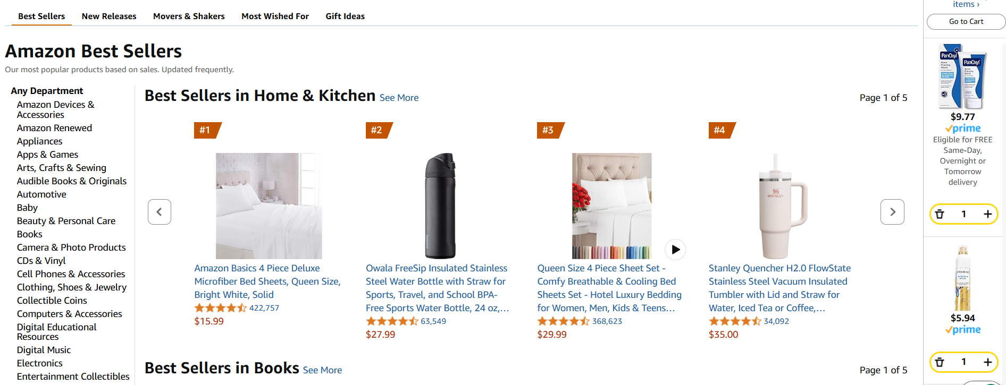
Data Acquisition and Overview - Amazon Dataset
Data Collection Process for item metadata and user reviews
A large-scale Amazon Reviews dataset collected in 2023, made publicly available on HuggingFace by McAuley Lab (UCSD).
This dataset contains 48.19 million items, and 571.54 million reviews from 54.51 million users.
Items span across 33 varied categories - Software, Amazon Fashion, Automotive, Grocery and Gourmet Food, etc.
4. Source also provides subsets for preserving user-item ratings only for those users that have written at least 5 reviews, for improved reliability.
Source: Amazon Reviews 2023 (huggingface.co)

Slide 8
Data Description - Amazon Dataset
Item Metadata
2. User Reviews
Parent ASIN: Unique identifier for item parent (Products with different colors, styles, sizes usually belong to the same parent ID).
Title: Name of the product.
Average Rating: Rating of the product shown on the product page.
Rating Number: Number of ratings in the product.
Features: Bullet-point format features of the product.
Description: Description of the product.
Main Category: Main category of the product.
Price: Price in US dollars (at time of crawling).
Store: Store name of the product.
User ID: Unique identifier of the reviewer.
Parent ASIN: Parent ID of the product.
Rating: Rating of the product (from 1.0 to 5.0).
Title: Title of the user review.
Text: Text body of the user review.
Timestamp: Time of the review (unix time).
Helpful Vote: Helpful votes of the review.
Verified Purchase: User purchase verification.
Usage in the recommendation system: This dataset provides the pool of items that influencers can choose from to promote useful and trending products that cater to their audiences. User reviews, ratings and product features can be used to perform content-based filtering and make more relevant recommendations.

Slide 9
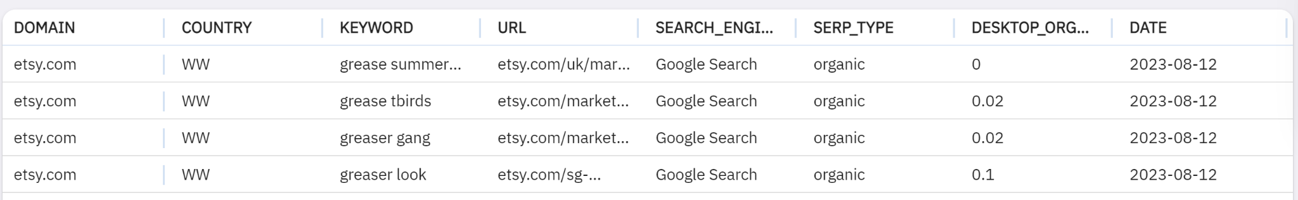
Data Description - Desktop Search Keyword Dataset
This dataset from Dewey provides insights into the keywords driving organic traffic to websites. With over 80 billion records, it captures search behavior and keyword trends, making it a valuable resource for understanding product demand in online marketplaces.
Domain: The website associated with the search.
Country: Geographical region of the search.
Keyword: The search term that led to a website visit.
Search Engine: The platform used for the query.
SERP Type: whether the click was organic or paid.
Search Volume Index: how often a keyword is searched.
Date: Timestamp of the search record.
Identify high-demand products based on search frequency.
Analyze consumer interests and emerging trends by tracking keyword performance.
Align product recommendations with search demand, ensuring influencers promote products with high potential for sales.
Source: Product Data Preview - Dewey (deweydata.io)

Slide 10
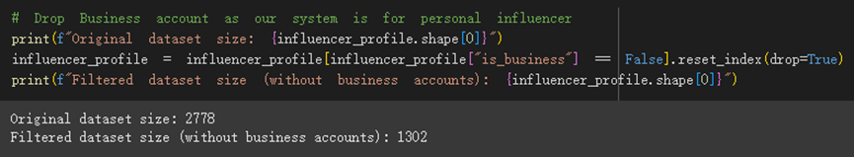
Profile Data Preprocessing - Data Type Conversion and Texts
Step 1: Drops business accounts and only keeps personal accounts for future analysis.
Step 2: Replace missing values with “other”, “unknown”, etc.
Step 3: Remove duplicated rows with the same user_id
Step 4: Convert data types to string or categorical data for columns like “user_id”,”category”.
Step 5: Standardize text data. Convert to lowercase and remove special characters.

Slide 11
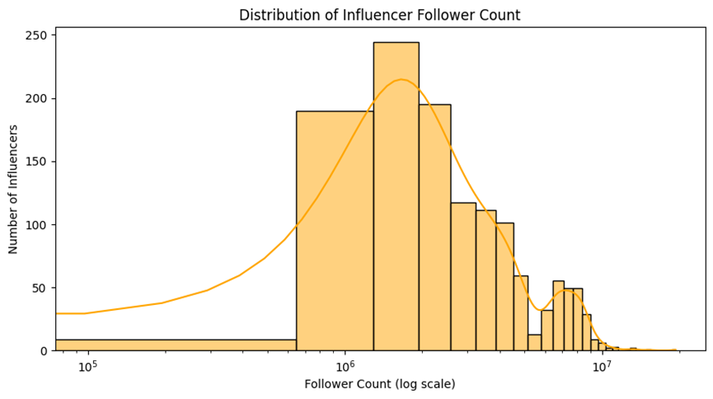
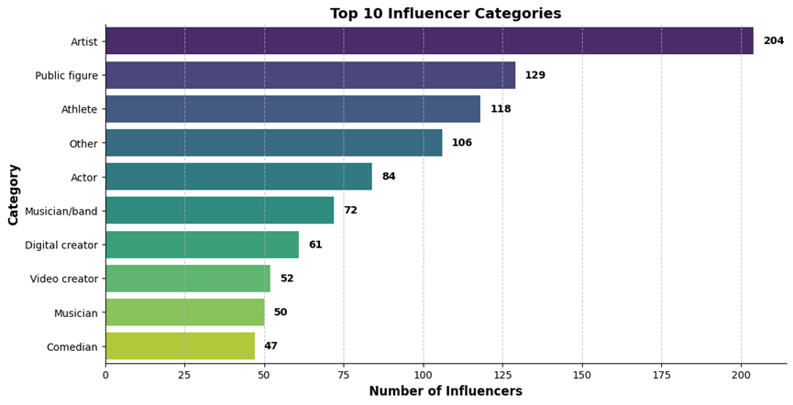
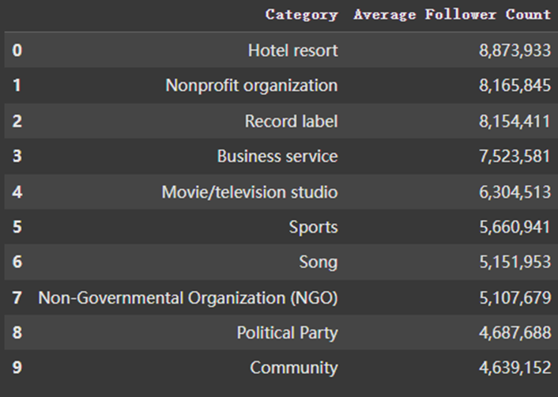
Profile Data EDA
Distribution of influencer followers: Followers counts mostly range from 100k to 1M.
Number of influencers by category: Artists, public figures, athletes and actor/actresses are the most populated categories.
Number of followers by category: Influencers in hospitality, nonprofits and record labels have on average the most number of followers.

Slide 12
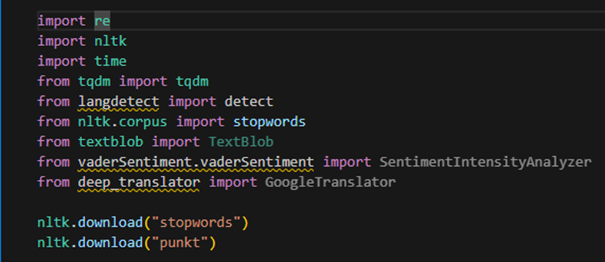
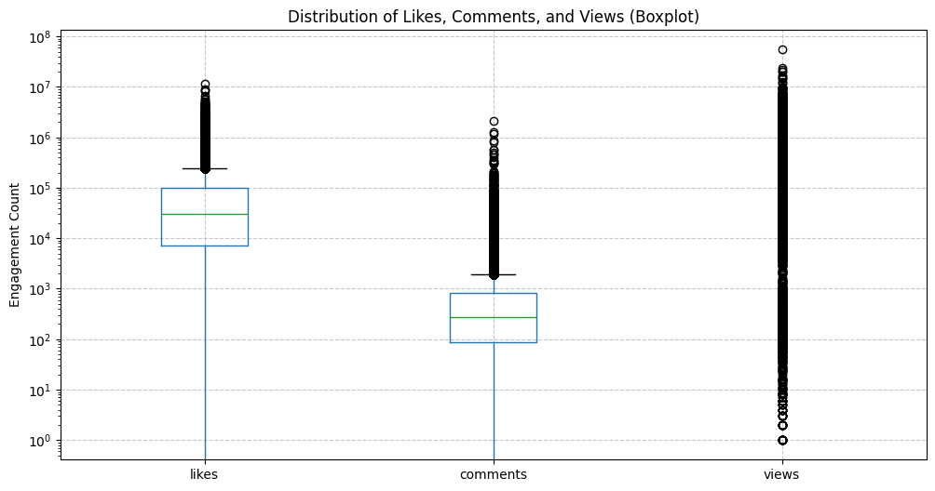
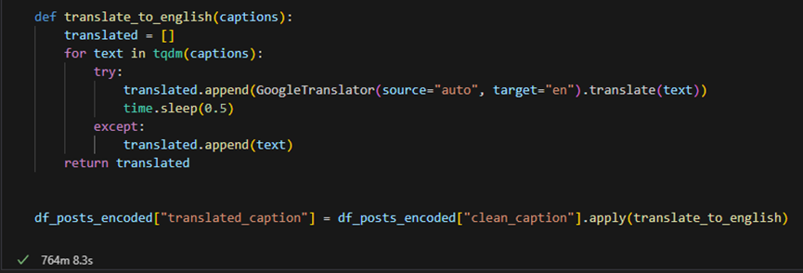
Posts Data Preprocessing - Sponsor Tags and Text Cleaning
Step 1: Drops rows with missing values (less than 10 rows deleted).
Step 2: Cleans and extract date details.
Step 3: Create “is_sponsored” column to identify influencer marketing behaviors.
Step 4: Outlier Detection & Handling: Remove outliers in likes, views, and comments columns
Step 5: Text cleaning, standardization, tokenization, and non-English-text-translation for future NLP analysis, using the NLTK library.

Slide 13
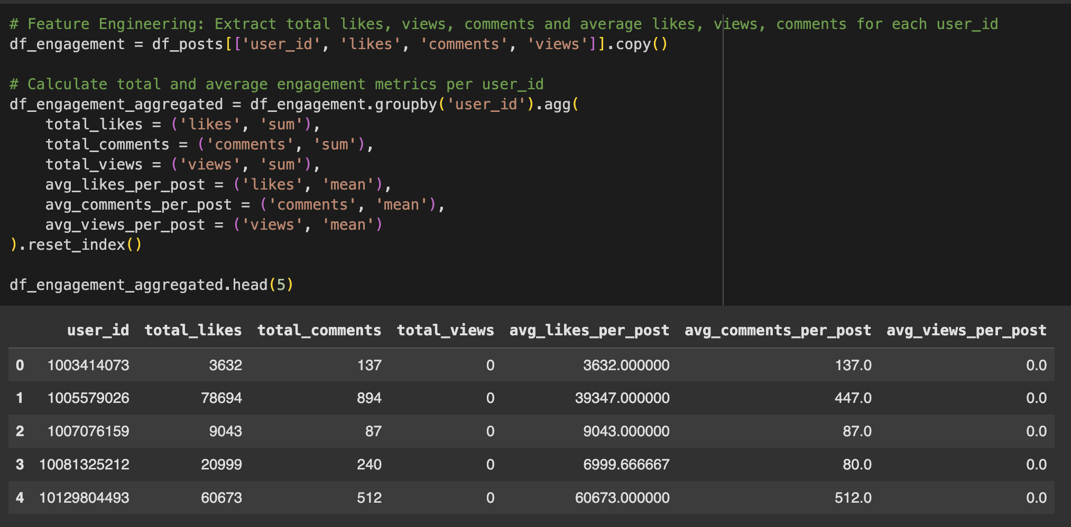
Posts Data EDA - Feature Engineering
Feature engineering:
Engagement Rate = (Total likes + Total comments) / follower_counts
Average number of likes, comments and views per post.

Slide 14
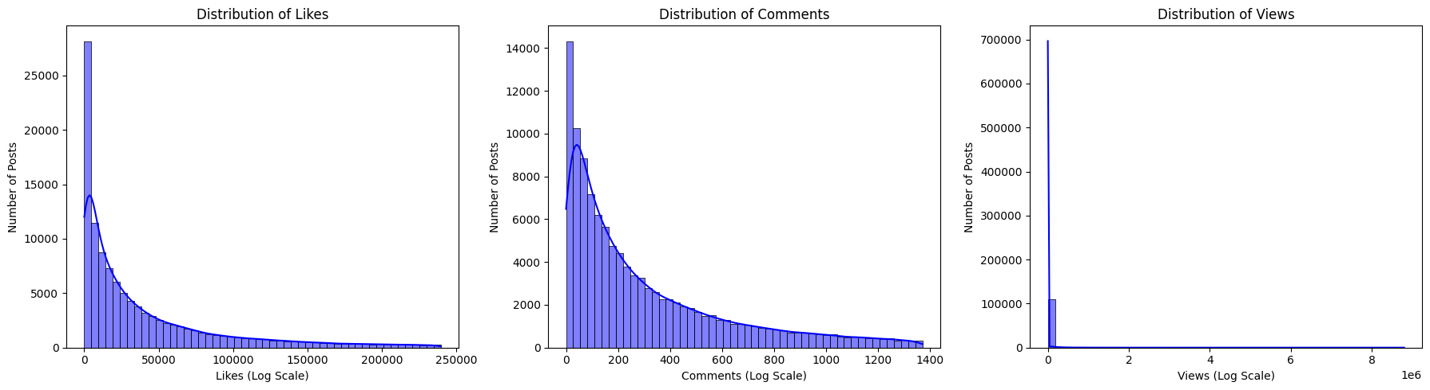
Posts Data EDA - Feature Engineering
Feature engineering:
Engagement Rate = (Total likes + Total comments) / follower_counts
Average number of likes, comments and views per post.

Slide 15
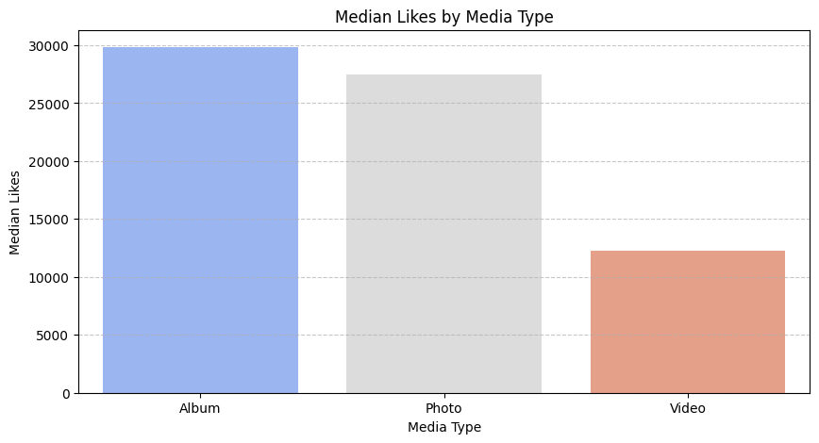
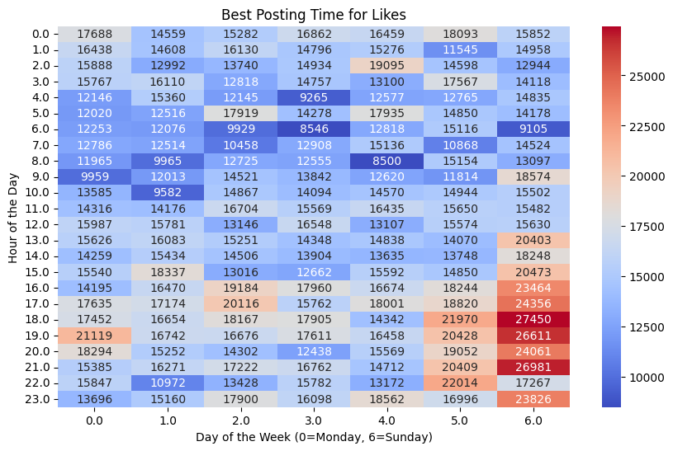
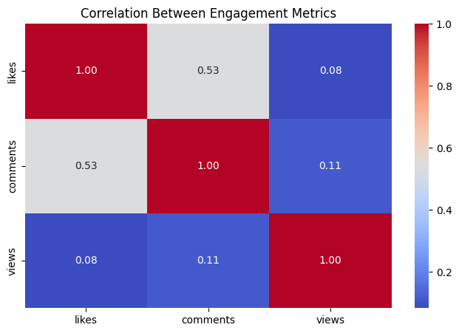
Posts Data EDA - Likes and Engagement
Most popular media type: Albums and photos are still the most popular media format on Instagram, judging from median likes per post.
Best posting time for likes: When we post stuff on weekend afternoons and evenings, we get the most likes.
Correlation between engagement metrics: Likes and comments are correlated. Higher number of views don’t necessarily mean higher likes and comments.

Slide 16
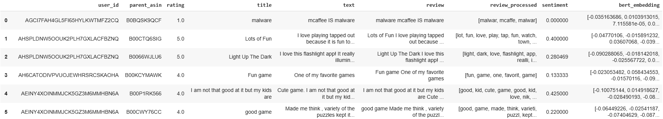
Amazon Reviews 2023: Data Processing
Text Processing for Reviews & Features: Basic text cleaning operations for removal of punctuation, digits & stopwords, tokenization and stemming, followed by calculation review sentiment polarity (TextBlob), and vectorization (explore different embeddings).
Feature Engineering: New attributes that account for temporal trends in ratings (e.g. moving averages), user sentiment, volume of reviews, seasonal variations, etc.
Datatype correction, handling null values: Price, Timestamp, Ratings, # Ratings, and other categorical variables. Additionally, remove reviews containing less than 5 words.

Slide 17
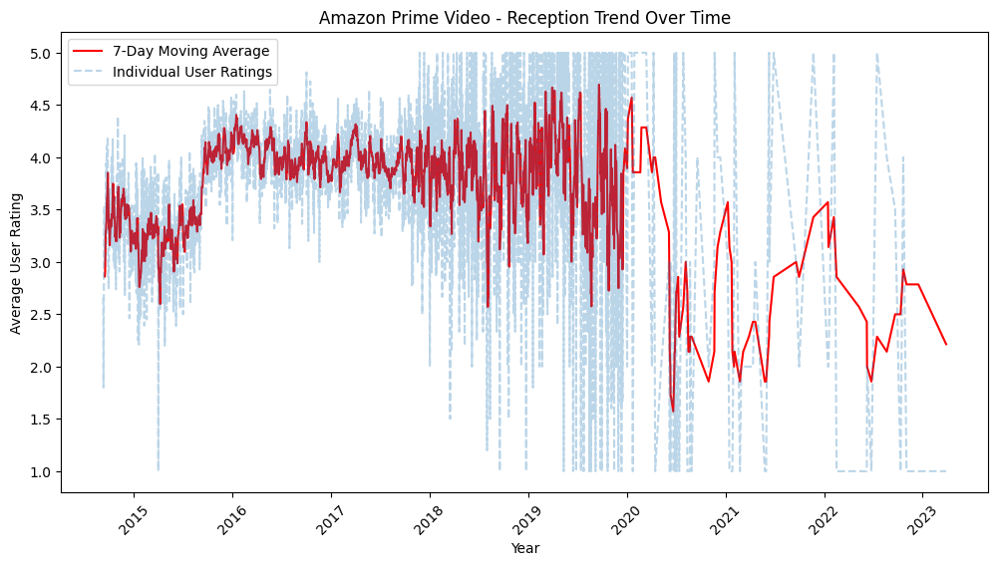
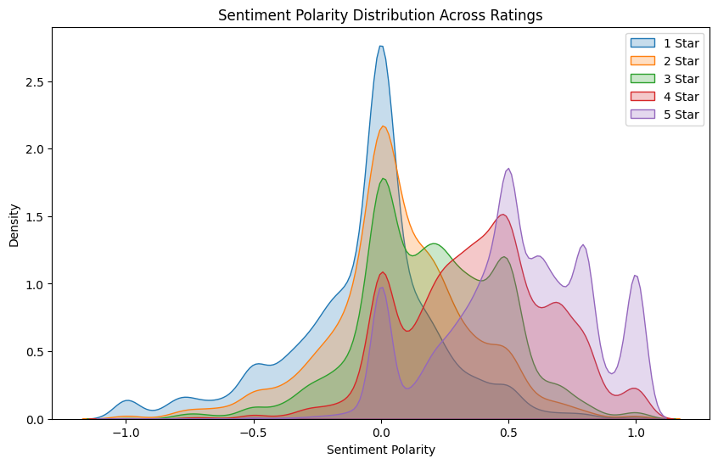
Amazon Data EDA - Software Category
Trends in user ratings over time: Accounting for trends in user ratings over time can help assess product reception and consequential impact on future sales.
Factual relevance of user reviews: Sentiments expressed by users align with their ratings, suggesting that the reviews may be factual. However, concentration around 0 (neutral) implies that reviews may be short or lack strong emotional wording.
Performed for a subset of 4,880,181 reviews for 89,246 Software items, written by 2,589,466 different users.

Slide 18
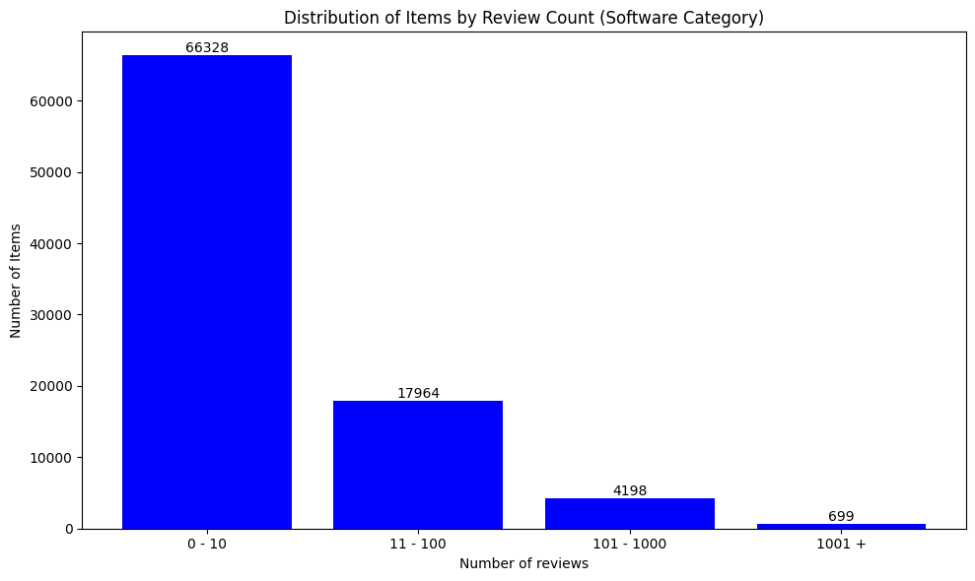
Amazon Data EDA - Limitations
Pricing information mostly unavailable: Pricing is a major factor that affects decision-making when a user is purchasing a product. (Unavailable (0.0/None) for ~81.84% of Software products)
Limited information about user: While user reviews are available, there is little information about the user demographics, preferences, usage history, etc., which might be highly relevant in assessing product performance and review relevance.
Average Ratings and Number of Ratings unavailable: Item metadata missing for a small portion of the data.
Skewed reviews per item: Most items have a very low number of written user reviews (0-10), giving lower context about what users feel about the product.

Slide 19
THANK YOU!

